Slide 1
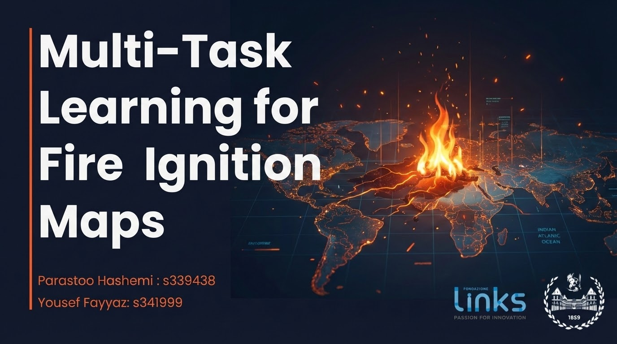

Slide 2
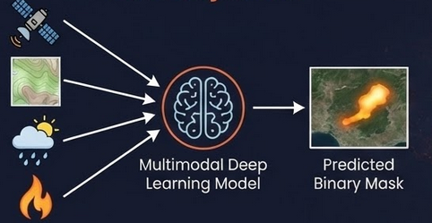
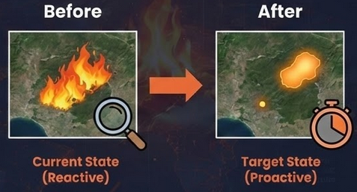
Project Objective
Core Objective
To develop a multimodal deep learning model capable of Predicting the final burned area extent of a wildfire right at the moment of ignition, using only pre-fire multimodal data that fused into a multimodal model
Input: Pre-fire environmental data (Satellite, Topography, Weather) + Ignition Point.
Output: Predicted binary mask of the final burned area.
The Paradigm Shift
Current State (Reactive): Remote sensing is primarily used for post-event damage assessment.
Target State (Proactive): To estimate the possible spread of fire immediately to allocate resources immediately during the "Golden Hour".

Slide 3




Value Proposition
Response Efficiency
Innovation & Scalability
Environmental Impact
The multimodal AI system generalizes across regions where Sentinel-2, Landsat, DEM, ERA5, and infrastructure layers are available.
The framework can be replicated globally, providing a reusable template for data-driven wildfire risk management.
Proactive predictions reduce environmental losses by enabling faster response before uncontrolled spread.
Fewer hectares burned → lower CO₂ emissions, preserved ecosystems, and reduced long-term regeneration costs.
Early burned-area forecasts help Civil Protection allocate firefighting teams, helicopters, and ground units efficiently.
Better situational awareness during the first critical hours improves containment and reduces operational risk.

Slide 4
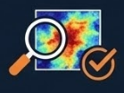
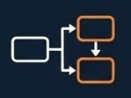
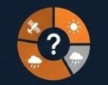
Research Questions
Can pre-fire multimodal data predict final burned area with sufficient accuracy to support early emergency decisions?
Do multi-task auxiliary objectives (e.g., land-cover segmentation) improve burned-area prediction?
which input data modalities contribute most to predictive performance?

Slide 5
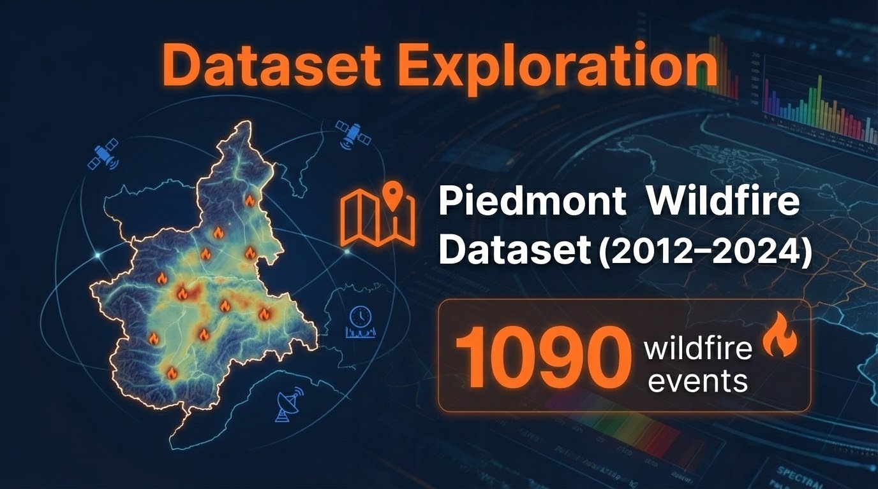

Slide 6

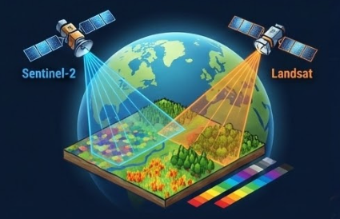
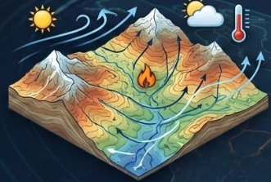
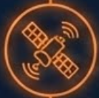



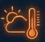
Pre-Fire Data: Satellite Imagery & Environmental Drivers
Satellite Imagery (Sentinel-2 & Landsat)
Environmental Drivers (DEM & ERA5)
Sentinel-2 Imagery: 12-band multispectral, 10-20m res.
why needed? captures immediate pre-fire condition
(vegetation & fuel availability)
Topograph (DEM): Terrain , slopes and valleys (30m res).
why needed? Fire spreads uphill, elevation is crucial for behavior.
Landsat Imagery: Extra spectral info (SWIR/NIR)
why needed? Sensitive to vegetation moisture and fuel dryness.
Complementary spectral response for fuel characterization.
ERA5 weather: Temperature & wind at ignition time.
why needed? Meteorological conditions are key drivers of fire expansion.
wind vectors provide essential dynamic information for propagation direction.

Slide 7
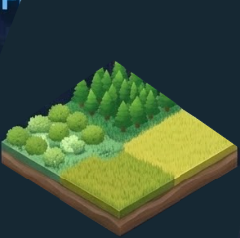
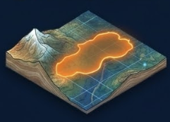

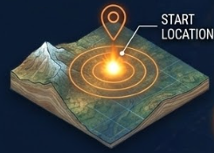
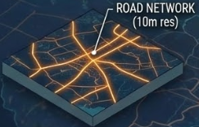
Land cover , Roads
Ground-Truth Fire Labels
(BURNED AREA MASK & IGNITION DATA)
Land cover Classification: Categorical mask of vegetation types (Forest, Shrub, Grassland, etc.).
why needed? Critical for estimating fuel type, Assists the model in differentiating propagation potential based on available fuel.
Burned Area Mask: Shape of the area that actually burned,
Binary Segmentation
(1 = burned, 0 = unburned)
why needed? Serve as a target label for supervised learning segmentation
Roads: Binary road mask (10m resolution).
why needed? Captures both human-caused ignition likelihood and fire break potential.
Ignition Data: The exact location where the fire started. (Binary marker), derived from Civil Protection point data.
why needed? The model learns how the fire is likely to spread from that specific starting position.

Slide 8
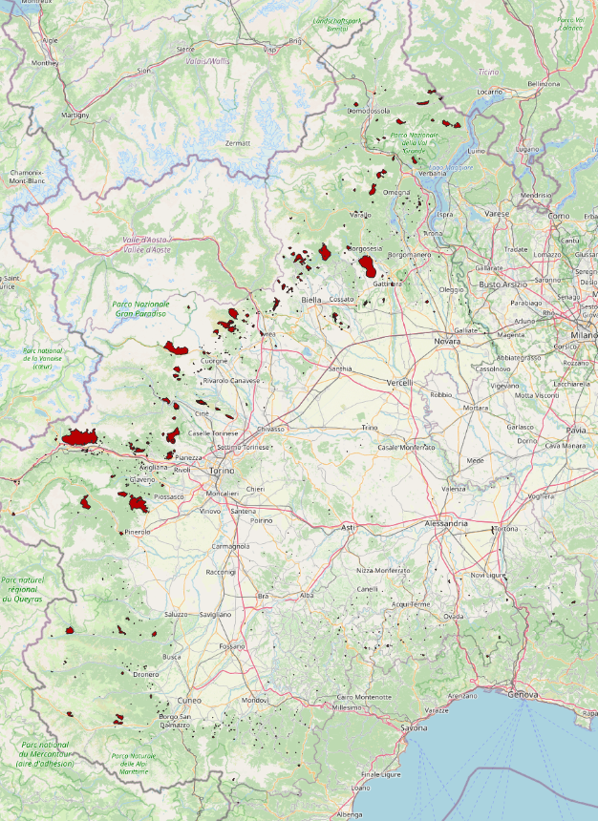
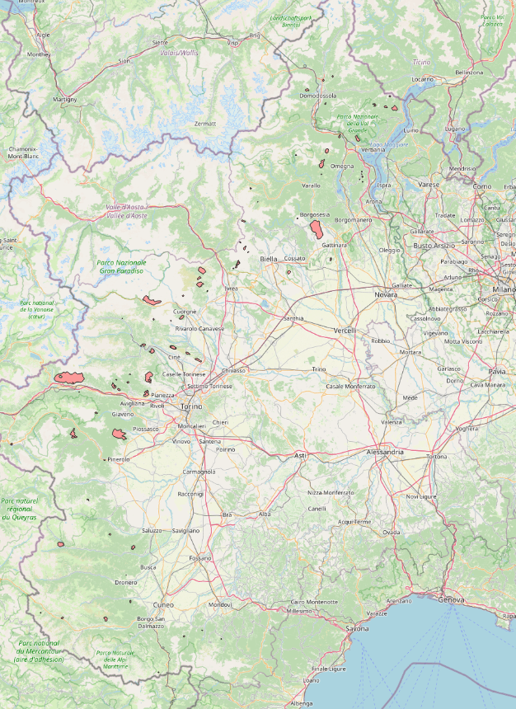
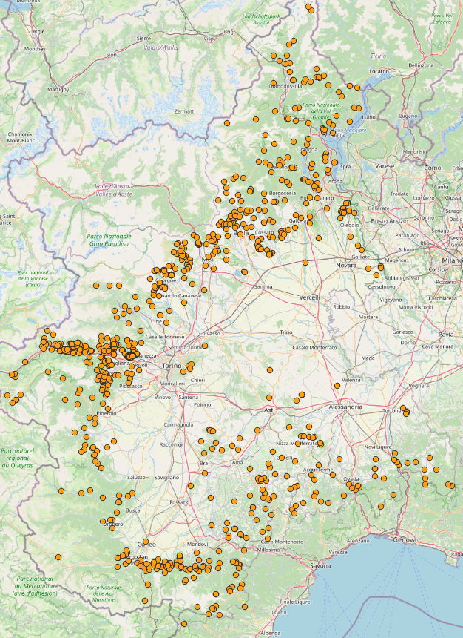
Full comparison Fires in Piedmont (areas only)
Civil Protection Area
EFFIS Area
Civil Protection Points

Slide 9
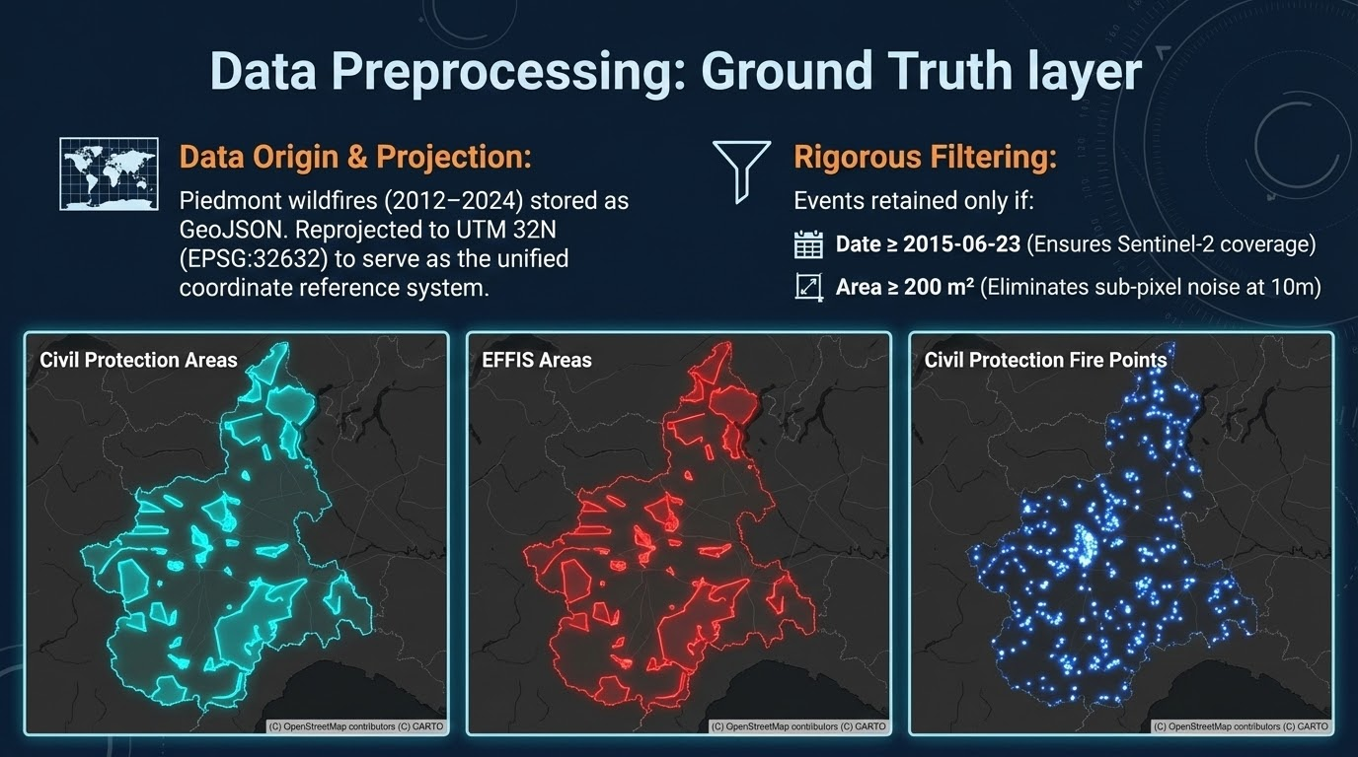

Slide 10
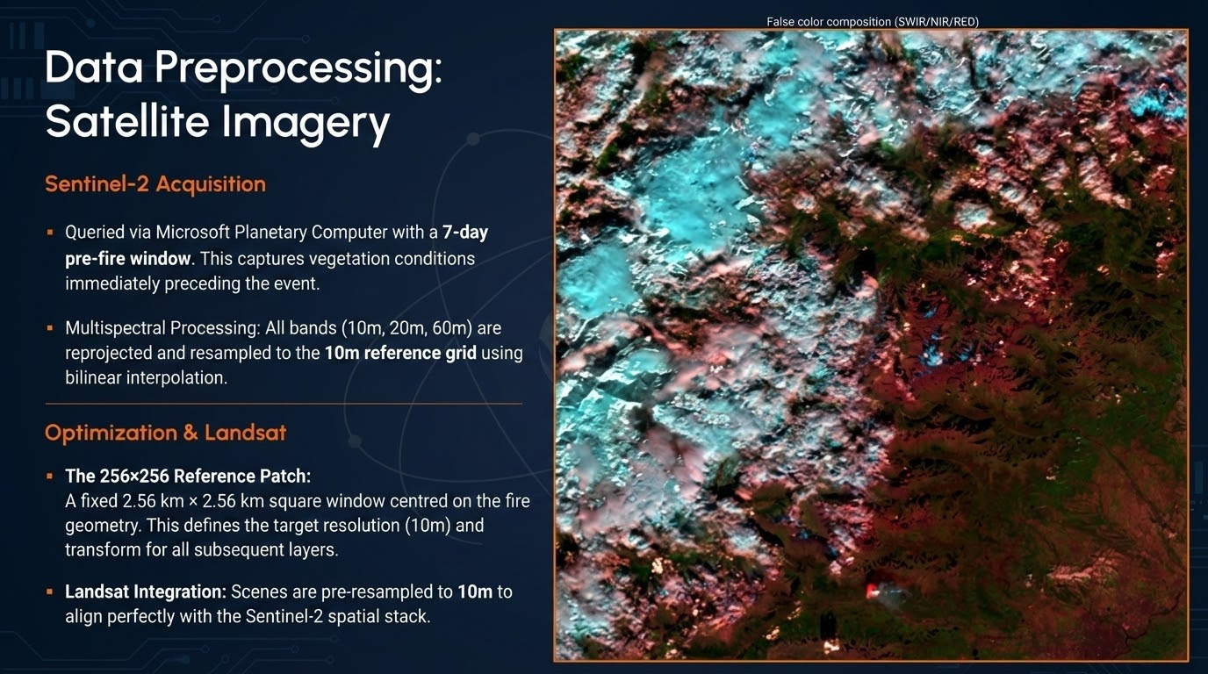

Slide 11
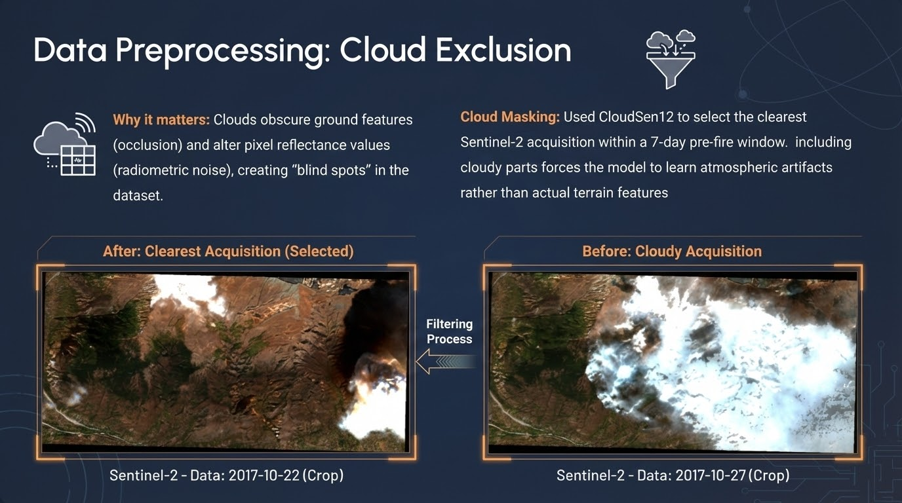

Slide 12
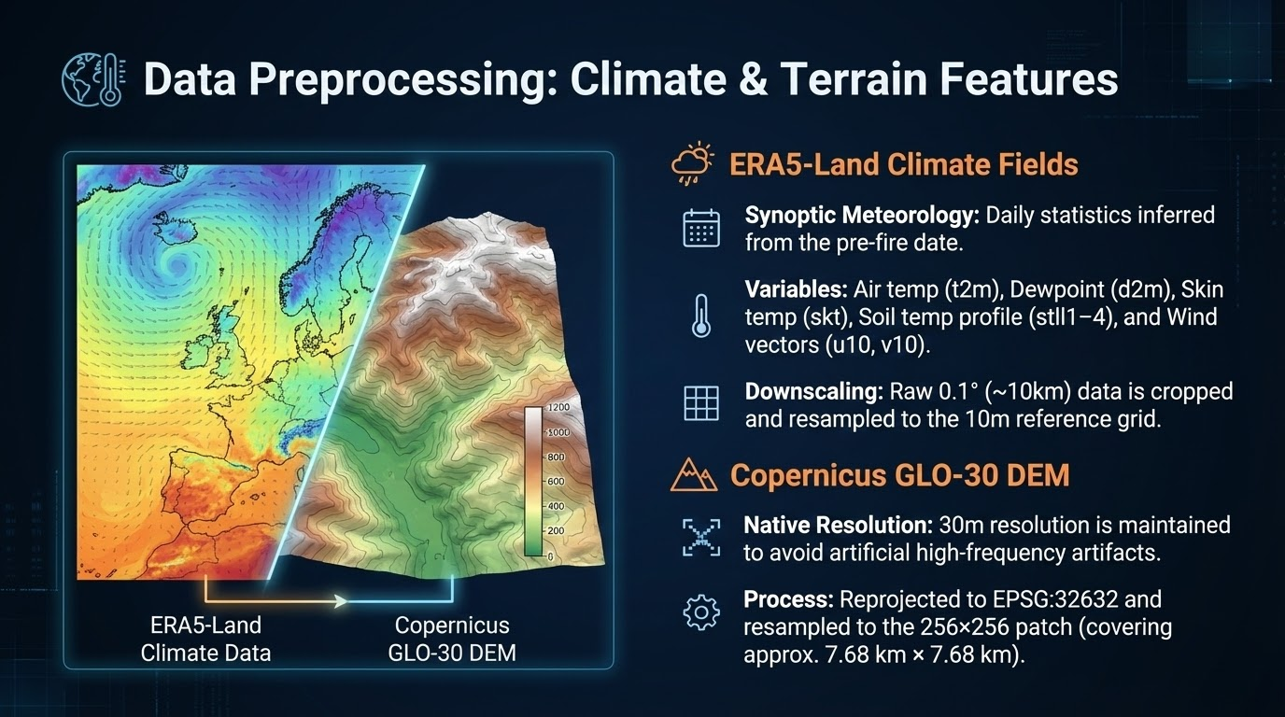

Slide 13
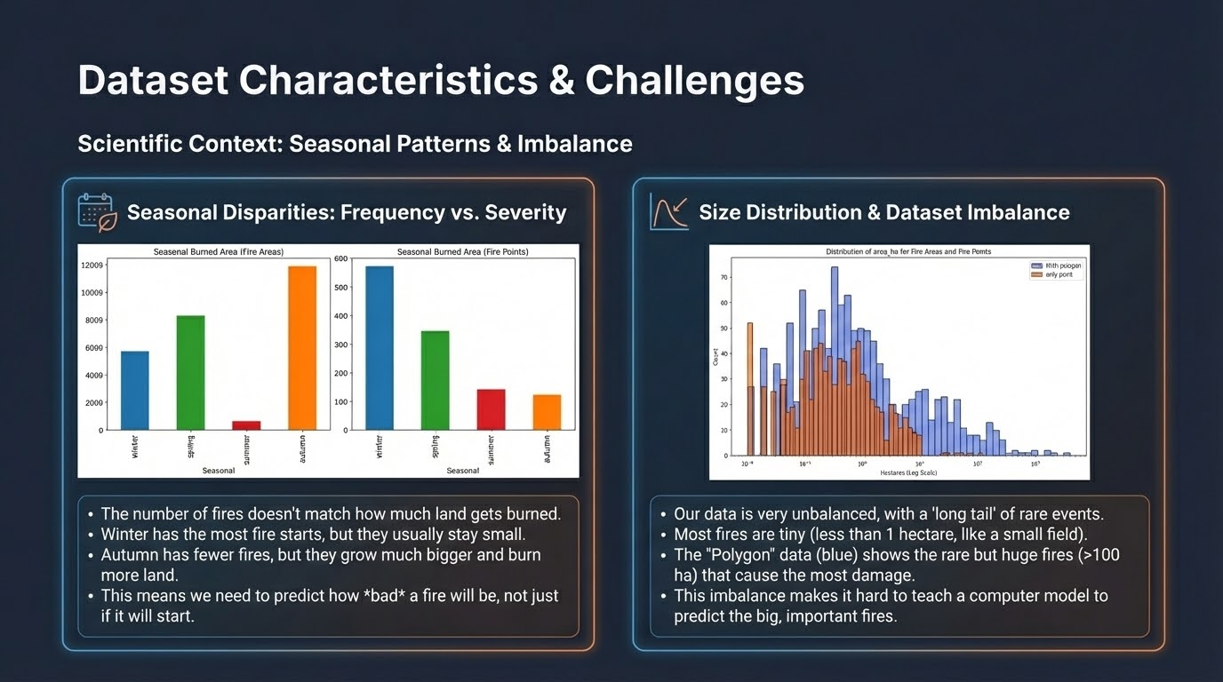

Slide 14
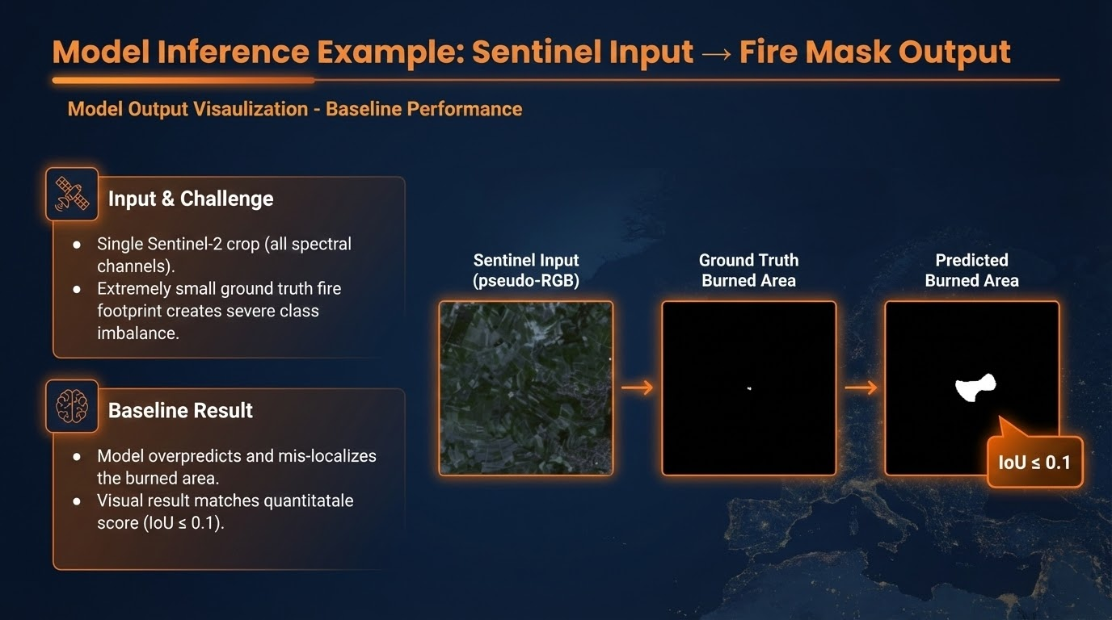

Slide 15
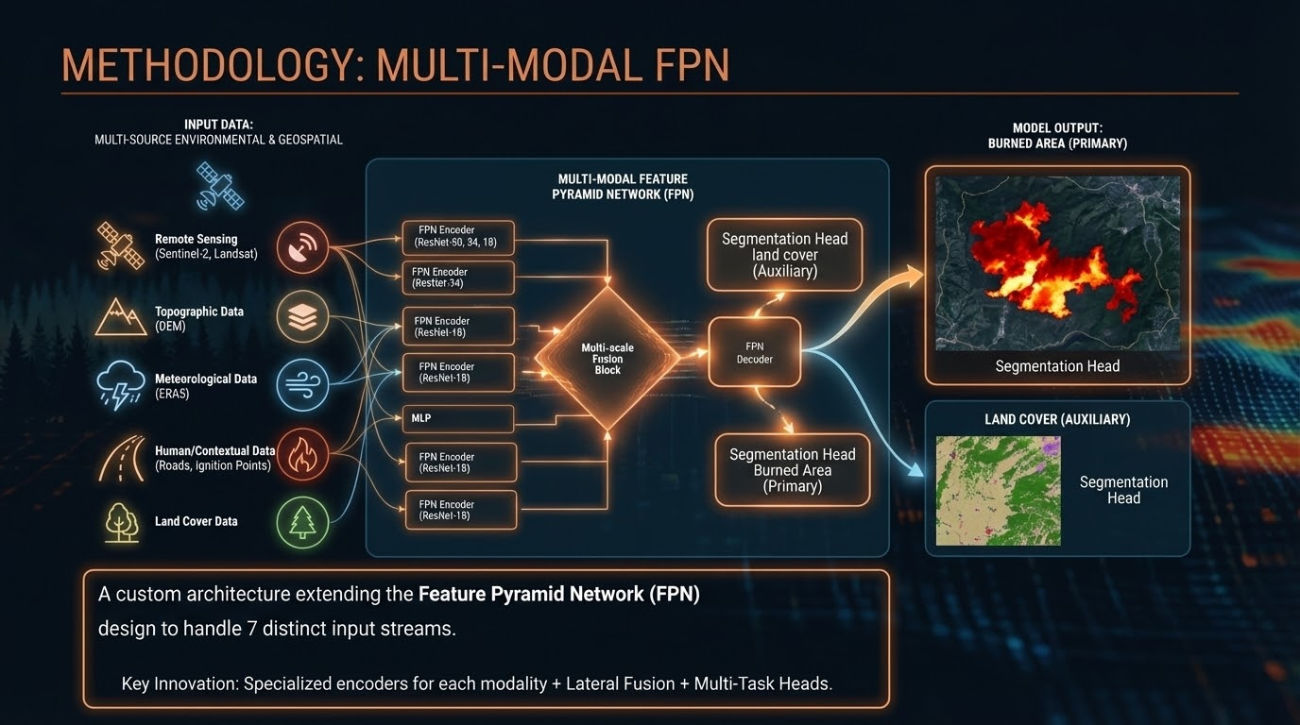

Slide 16
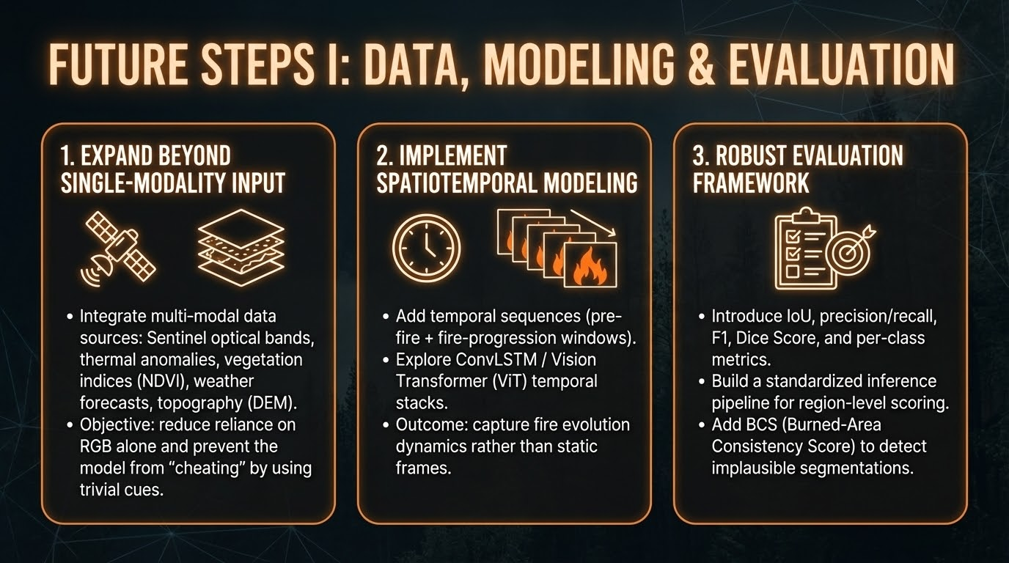

Slide 17
Thanks for the attention
Any questions ?

